Slide 1
Detector Support Group Select Projects
Amrit Yegneswaran

Slide 2
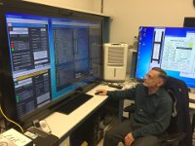
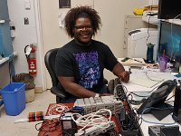
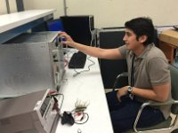
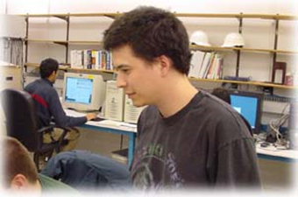
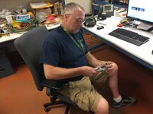
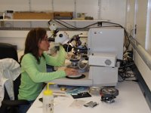
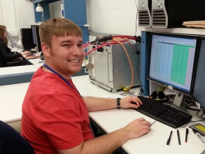
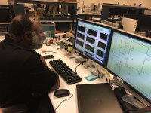
DSG Staff
Mary Ann (20) Peter (27) Aaron (<1)
Pablo (4) Brian (20) George (5)
Mindy (20) Tyler (4) Marc (23)
Give me the child for the first seven years and I will give you the man. Jesuit maxim widely attributed to Ignatius Loyola
DSG is all about teamwork

Slide 3
Contents
Hall A
SBS & BB: cable fabrication; super-module fabrication; GEM gas system
HRS: dipole magnet power supply's controls and monitoring system
Hall B
RICH: cooling; humidity and temperature sensor
Torus & Solenoid: readout system
Hall C
HMS/SHMS: magnet HMI screens → CSS-BOY; HV Tcl/Tk screens → CSS-BOY
NPS: testing of CAEN SY4527
Hall D
Solenoid: upgrade of PXI system; WEDM screens
DSG
Accelerator: populating VME fast shutdown board, wire-bonding tests
R&D & Safety: Test stations; focus on safety

Slide 4
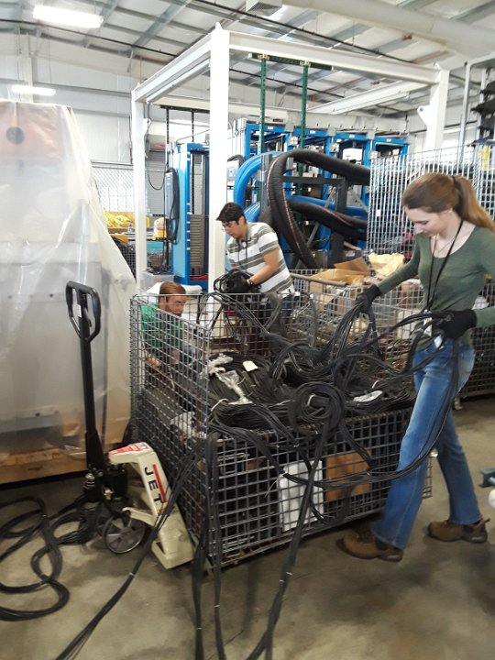
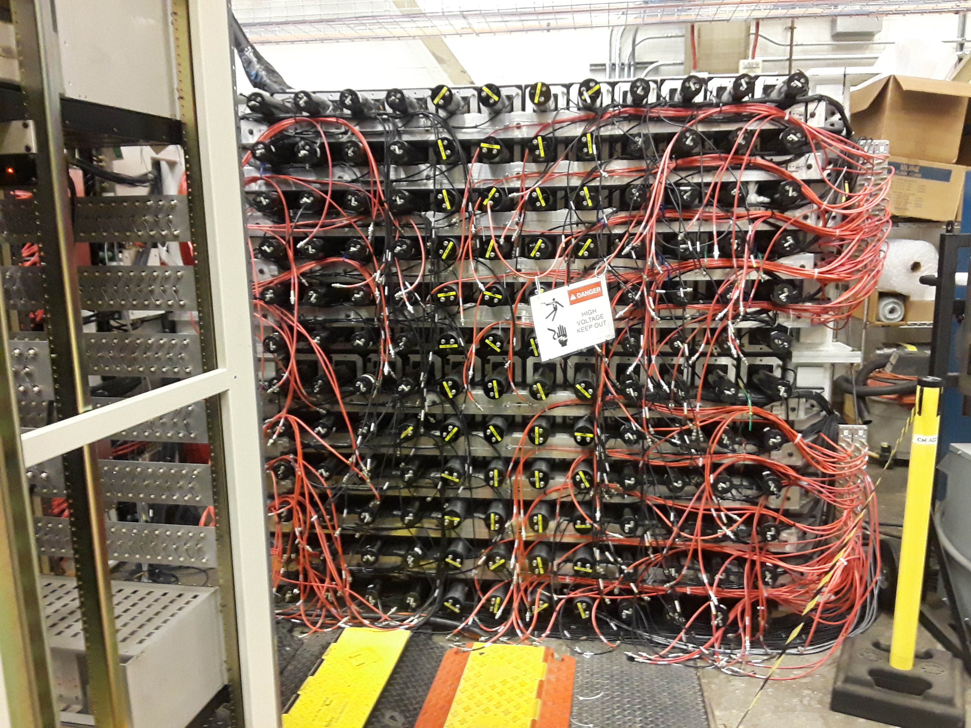
Hall A: SBS Cable Fabrication and Routing
Cable fabrication for HCAL
Search, seize, and secure cables in ESB
95% of ~1888 cables fabricated
HCAL HV cable labeling and routing
~300 HV cables routed on HCAL in Test Lab
Search, seize, and secure cables in ESB
DSG Note 2019-45
“He believed in youth and youth made him its confidant”
dedication to George Edward Cunnigham, Berkeley CA

Slide 5
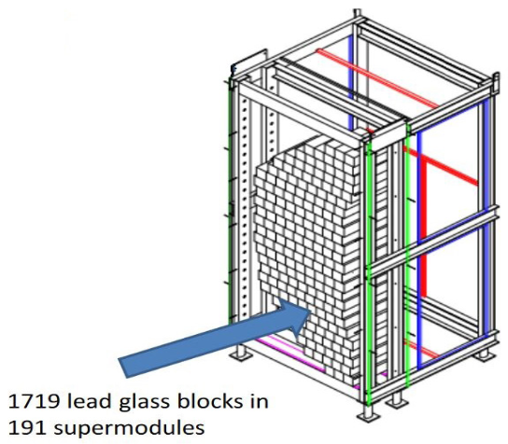
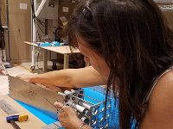
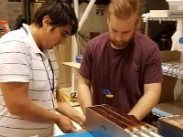
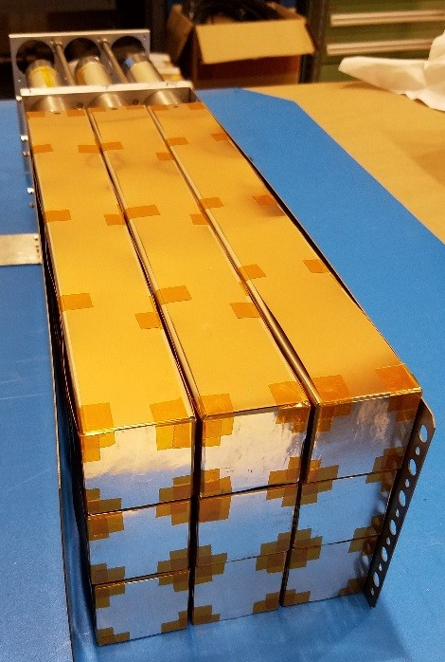
Hall A: BB ECAL Super-module Assembly
126/191 super-modules assembled.
Each super-module has:
Nine lead-glass blocks with light guides
Wrapped in aluminum foil and copper
Support frame with screws, springs, and plates hold them in place
DSG Note 2019-48
Top: diagram of BigBite ECAL showing configuration of 191 super-modules
Left: Partially assembled super-module showing the nine wrapped lead-glass blocks. Light guides are on opposite end of blocks in photo

Slide 6
Hall A: SBS & BB GEM Gas System
INFN Layer Configuration
3 modules per layer
1 gas line per layer
M1
Ar/CO₂
_{70%:30%}
M2
M3
M1
M2
M3
Layer
UVA Layer Configuration
4 Modules per layer
4 Gas line Per layer
M1
M2
M3
M4
Ar/CO₂
_{70%:30%}
M1
M2
M3
M4
DSG Talk 2019-17
Layer

Slide 7
Hall A: SBS & BB GEM Gas System
manifold 2

Slide 8
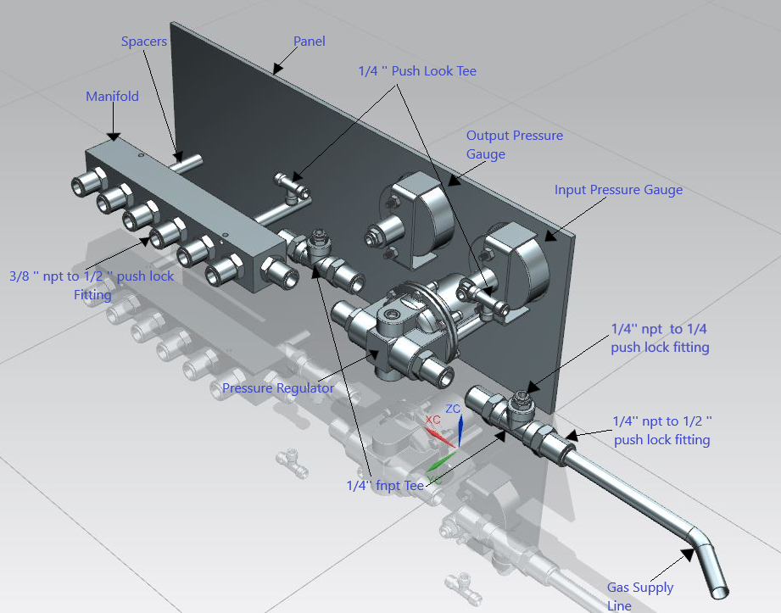
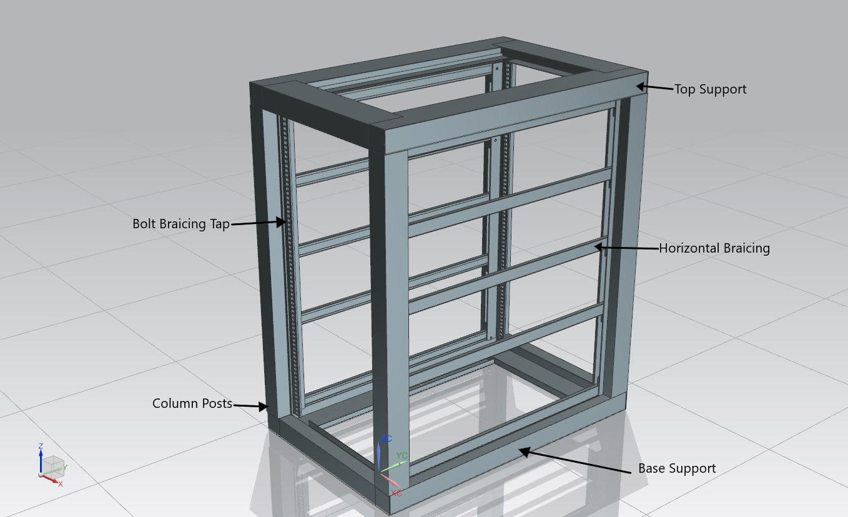
Hall A: SBS & BB GEM Gas System
Developing 3D-CAD model of gas system in NX-12
Isometric View of GEM Gas System’s components
Isometric View of GEM Gas System’s rack assembled

Slide 9
Hall A: SBS & BB GEM Gas System
Honeywell Zephyr Evaluation
DSG Talk 2019-17, DSG Note 2019-49, DSG Note 2019-50

Slide 10
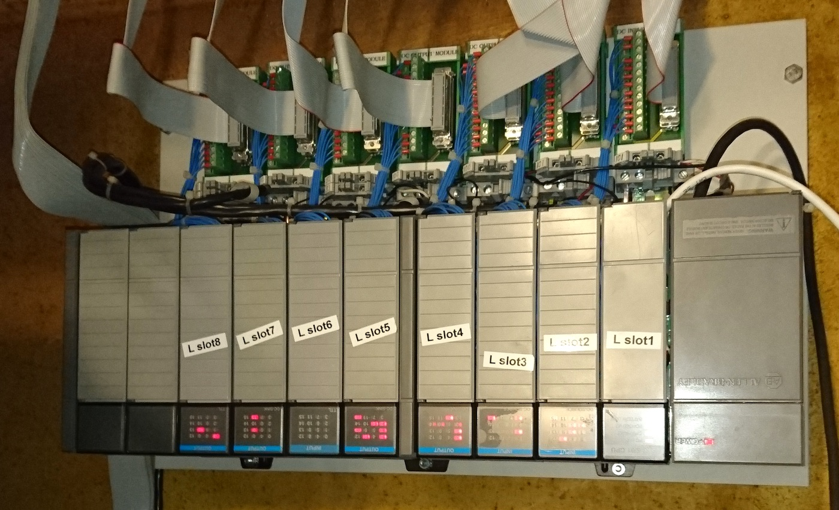
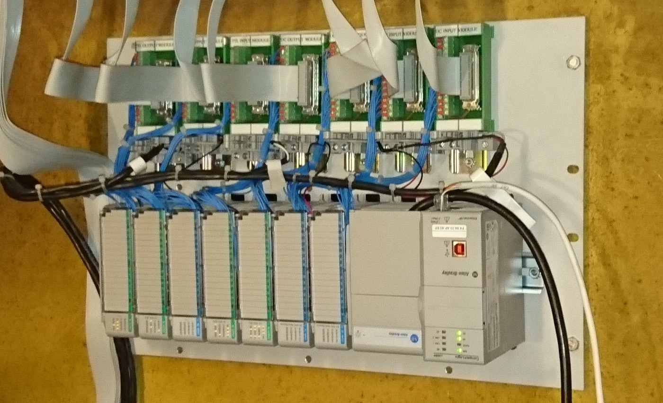
Hall A: Dynapower PLC Control System
Upgrade of PLC used in HRS Dipole Magnet Power Supplies
Evaluated potential systems (different vendors & products)
Setup (code development) and deployed selected system
DSG-Note 2019-29, DSG-Note 2019-40
OLD – SLC500
NEW - CompactLogix

Slide 11
Thanks Jack
Dsg-halla <dsg-halla-bounces@jlab.org>
on behalf of Jack Segal <segal@jlab.org>
Tue 6/11/2019 8:34 PM
Brian, Many thanks to you and the DSG. The Left Dipole finally seems to be doing what it was intended to do 24 years ago. It now has redundant protections that function correctly. Your prompt help while I was trying to understand how things were configured and how to correct the errors is much appreciated. Again, thanks!
DSG’s inner child

Slide 12
Hall B: RICH Cooling Investigation
Electronic Panel
Internal cabling
Red ~ HV
Gray ~ LV
Light gray ~ Sensor
Green ~ Data

Slide 13
Hall B: RICH Cooling Investigation

Slide 14
Hall B: RICH Cooling Investigation

Slide 15
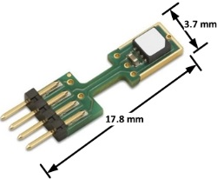
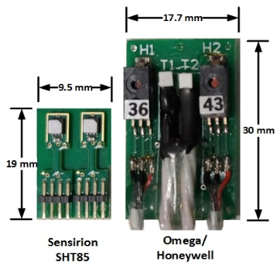
Hall B: Sensors for New RICH
Improve temperature and humidity slow-controls measurement systems for next RICH sector.
Sensirion SHT85 Sensor
New product released on 11/2018
Accuracy
Humidity: ±1.5% RH, temperature: ±0.1°C
Compare to currently used Honeywell/Omega
Smaller size of sensor assembly
Reduced # of cables/connectors
Compatible with existing slow-controls electronics
Compatible software support (including EPICS)
Lower cost
DSG Note 2019-43

Slide 16
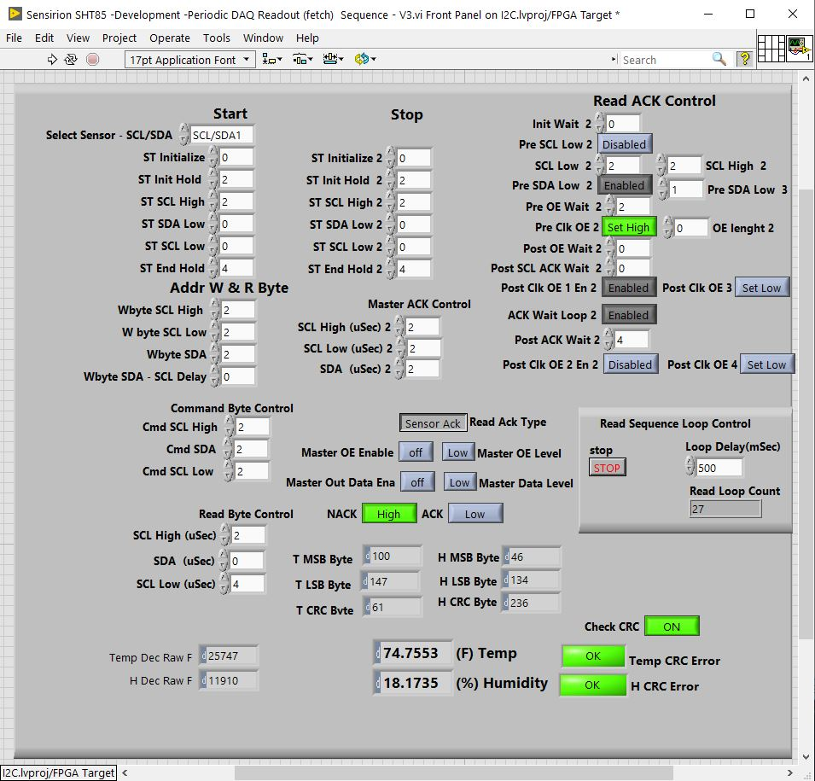
HallB: Sensors for New RICH
Developing FPGA code
Addressed issue with single-shot readout sequence
Testing in progress
DSG Note 2019-44
DSG Note 2019-47
Serial Communication Timing Test Screen

Slide 17
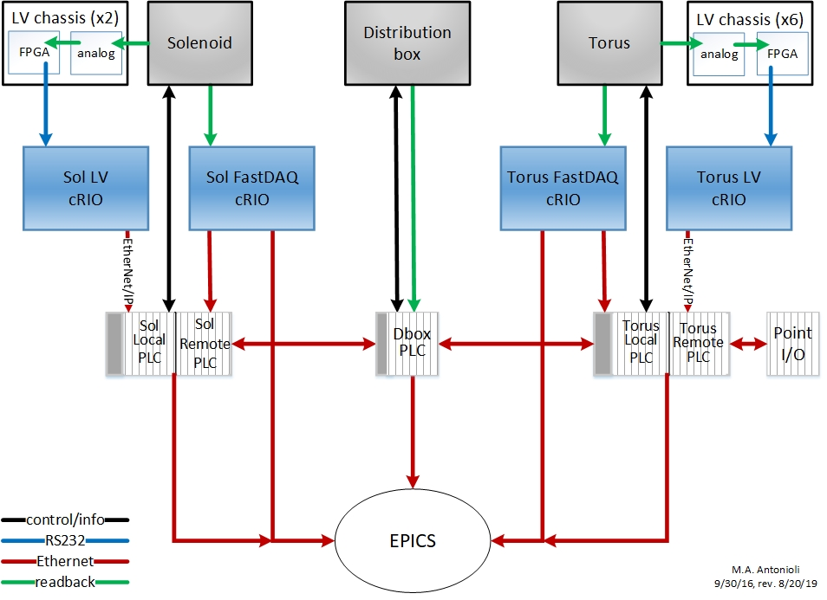
Hall B: Solenoid and Torus Magnet Readout System
Replace current LV Chassis FPGA with DE0-Nano-SoC or some other improved FPGA board
LV cRIOs have failed, removing them eliminates point of failure
New board would communicate directly with PLC
DSG Talk 2019-24
DSG Note 2019-53
Present readout configuration

Slide 18
Thanks Ruben
Dsg-hallb_magnets
on behalf of Ruben Fair
Thu 9/5/2019 10:11 AM
Tyler and the DSG, This is excellent work. Great report and summaries.
We very much appreciate your contribution and your continuous improvement efforts. Looking forward to seeing which solution is the most reliable and cost effective.
Thank you
Ruben
DSG’s inner child

Slide 19
Hall C: HMS/SHMS Magnet HMI screens to EPICS CSS-BOY
Motivation
Standardization
Enables data archiving and thereby facilitates debugging
Enhancements of display and functions facilitates magnets’ controls and monitoring
275 HMI screens need to be addressed
DSG Note 2019-20
DSG Note 2019-22
DSG Note 2020-02
DSG Talk 2019-07
DSG Talk 2019-13

Slide 20
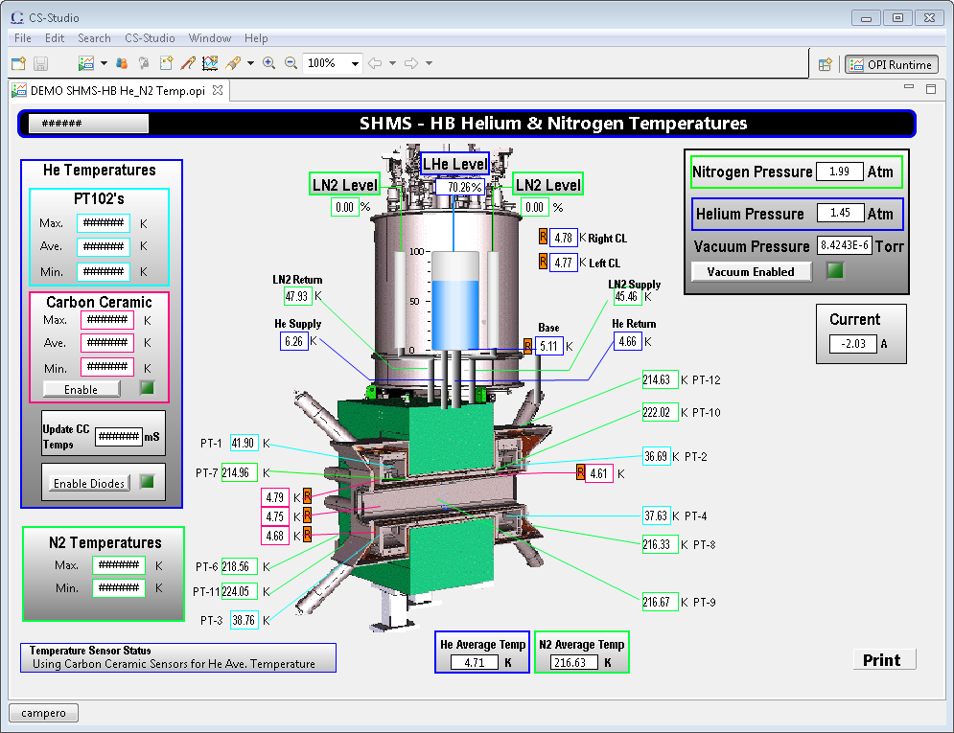
Hall C: HMS/SHMS Magnet HMI screens to EPICS CSS-BOY
CSS-BOY screen for SHMS – Horizontal Bender magnet’s Helium and Nitrogen temperatures.
This screen combines Helium and Nitrogen HMI PLC screens.

Slide 21
Hall C: HV Tcl/Tk system to EPICS CSS-BOY
Motivation for CSS
Standardization
Faster
Opens screens in seconds as opposed to minutes (yawn)
Screens are static and do not have to be rebuilt unless configurations change
Uses a Python script to build screens based on configuration files.
Script builds all screens in seconds
Includes CSS-compatible backup/restore program and start-up script.
Start-up script allows multiple instances of screens to be opened simultaneously and provides a consistent user experience for all users
DSG Note 2019-27, DSG Note 2019-34, DSG Note 2019-36, DSG Note 2019-42
DSG Talk 2019-13

Slide 22
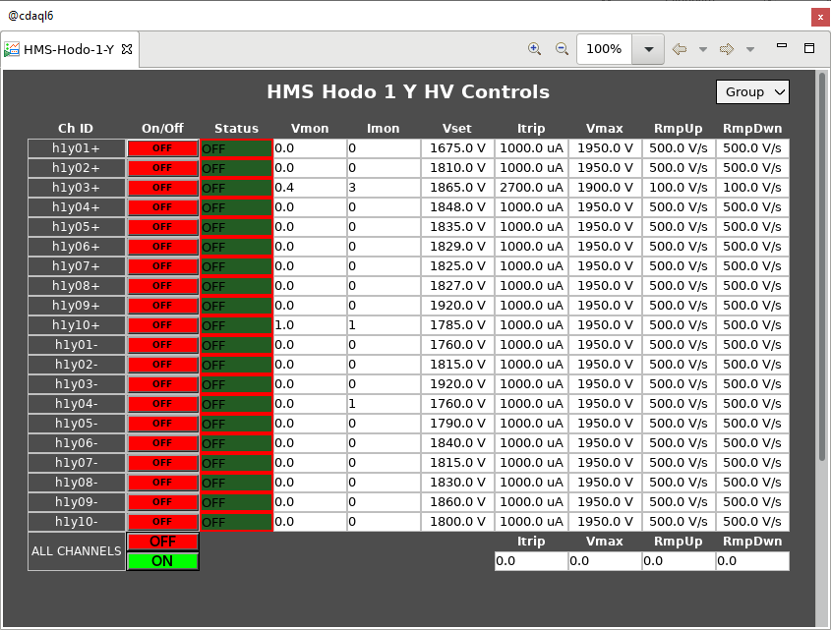
Hall C: HV Tcl/Tk system to EPICS CSS-BOY
List-view controls screen for HMS Hodoscope 1 Y.

Slide 23
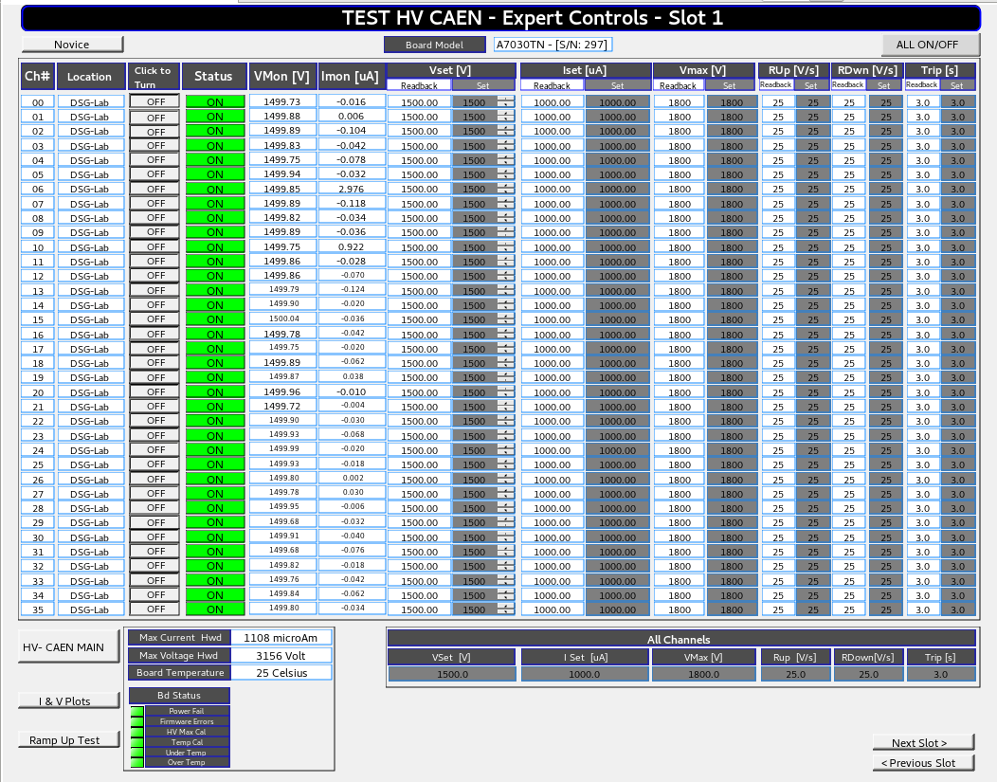
Hall C: Investigation of CAEN SYS 4527 and HV cards A7030TN
Issues with SY4527 and HV card A7030TN
Changing set values of parameters
Ramp-up latency
Ignoring commands
DSG Note 2019-46
DSG Note 2019-54
DSG Note 2020-01
DSG Talk 2019-18
DSG Talk 2019-23
DSG Talk 2019-28
HV CAEN Expert Controls CSS-BOY screen developed for testing

Slide 24
Hall C: Investigation of CAEN SYS 4527 and HV cards A7030TN
Ramp-up latency

Slide 25
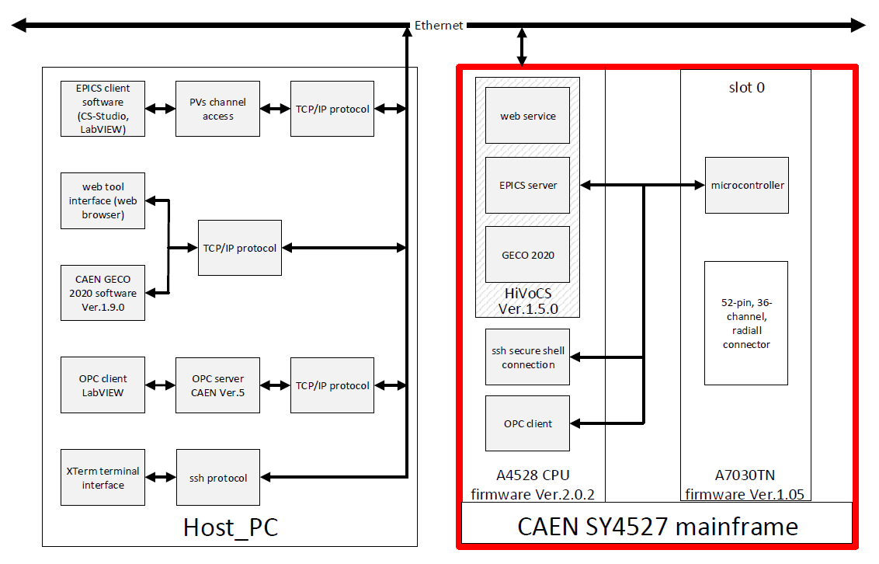
Hall C: Investigation of CAEN SYS 4527 and HV cards A7030TN
Test system configuration possibilities

Slide 26
Thanks Alberto
Dsg-hallc_controls <dsg-hallc_controls-bounces@jlab.org>
on behalf of
Alberto Lucchesi <a.lucchesi@caen.it>
Fri 9/13/2019 8:25 AM
Dear Pablo, thanks to your suggestions we were able to reproduce the same test as described in your document and we found some interesting information…
Dsg-hallc_controls <dsg-hallc_controls-bounces@jlab.org>
on behalf of Alberto Lucchesi <a.lucchesi@caen.it>
Mon 9/30/2019 7:26 AM
Dear Pablo, from the log I'm convinced that the ramp delay is something related to the board firmware. I say this because looking the log it is clear that all the power on commands are received by the boards at the same time, but for a reason that we have to understand, sometime a channel doesn't perform the ramp correctly but its first 5/6 steps are anomalous…
DSG’s inner child

Slide 27
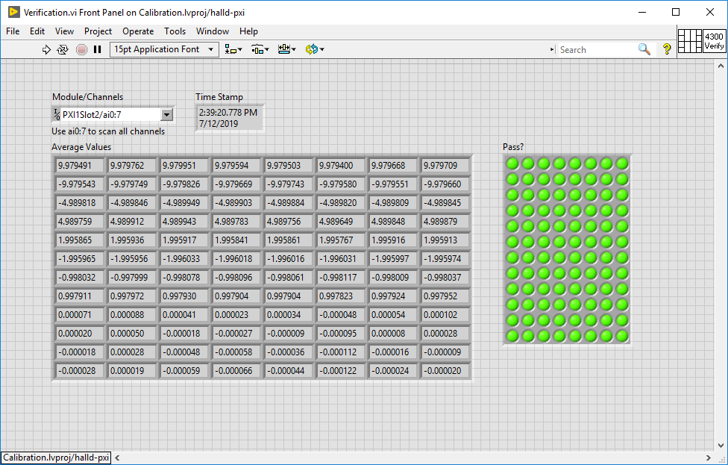
Hall D: Upgrade of PXI system
Upgrade and maintenance of PXI system used for FastDAQ (10 kHz to EPICS) of solenoid signals
LabVIEW upgraded to 2019, ADC module calibrations performed
DSG Note 2019-52
ADC Calibration for Slot 2

Slide 28
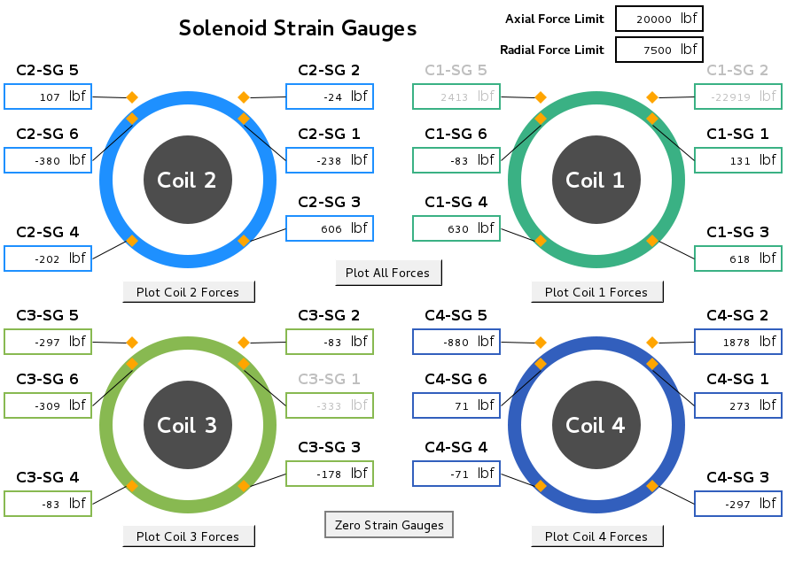
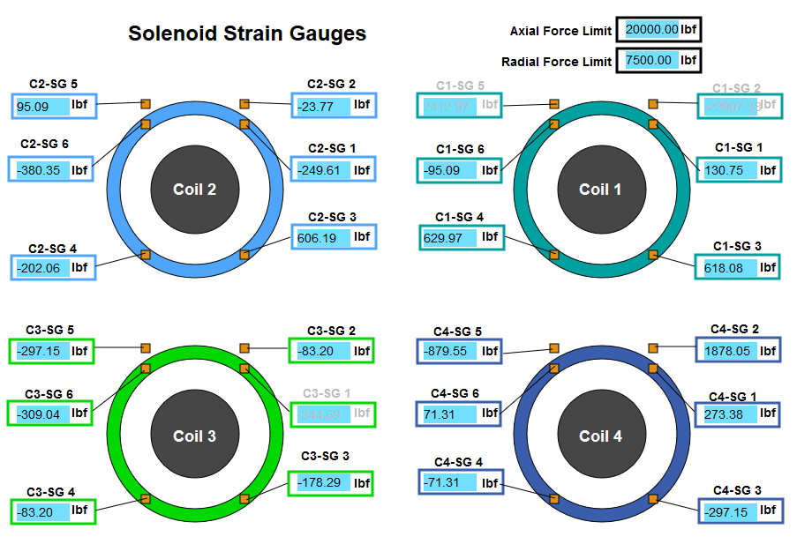
Hall D: WEDM
19 CSS screens converted to WEDM for off-site monitoring.
WEDM allows read-only EPICS screens to be viewed from offsite from a web browser with a JLab CUE login.
Solenoid Strain Gauges CSS screen
Solenoid Strain Gauges WEDM screen
DSG Note 2019-51, DSG Talk 2019-19

Slide 29
Thanks Tim
whitey@jlab.org
Re: [Dsg-halld_plc] Hall D WEDM status
Dsg-halld_plc
on behalf of Timothy Whitlatch
Mon 6/24/2019 9:25 AM
Hi Tyler, This is a great start.
ComCal Environment is fine
DIRC Environment is fine
Main Gas System GUI is fine
CDC Gas system not needed
FDC gas system not needed Gas system solenoid valve monitor not needed
hall temperature is fine
Solenoid Cryo is fine
Solenoid Interlocks is fine
Solenoid strain gauges is fine
Solenoid vacuum is fine
Solenoid voltage taps is fine Can the Hall camera screens be linked?
Thanks,
Tim
Dsg-halld_plc
on behalf of Timothy Whitlatch
Mon 7/15/2019 10:30 AM
Hi Tyler,
This is very nice and very useful! Thank you for following through on this.
Tim Whitlatch
Hall D Engineer Jefferson Lab
757-269-5087
DSG’s inner child yet again!

Slide 30
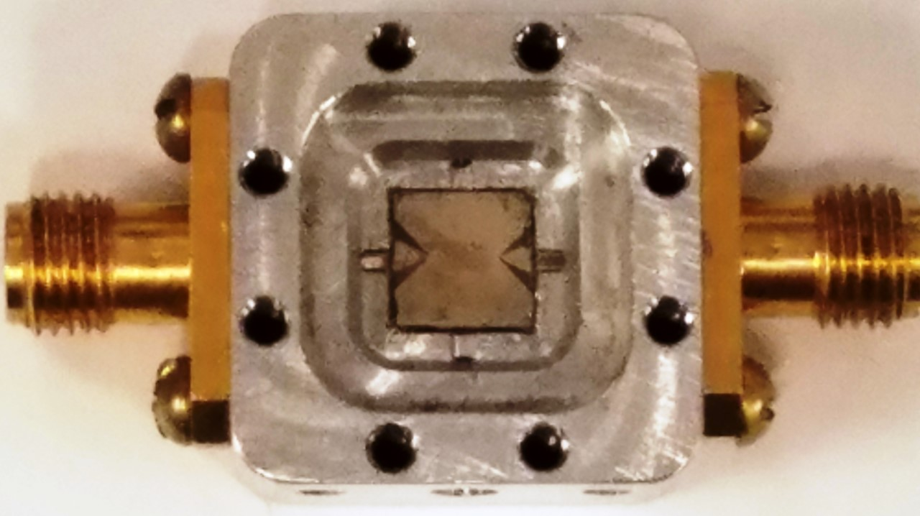
DSG: Accelerator
Populating of VME fast shutdown boards for accelerator
DSG Note 2019-25
Wirebonding
Sample made of superconducting Nb3Sn, and what is patterned on the surface is a resonator.
Will be cooling down sample to 4K - 2 K and measure how much energy gets dissipated in heat at a frequency around 2-3GHz. (Junki Makita)

Slide 31
DSG: R&D and Safety
NI cRIO Test Station development
LabVIEW program to test 18 different types of cRIO modules
18 different types of modules tested
DSG Note 2019- 17, DSG Note 2019-30
PLC Test Stand development
DSG Note 2019- 23
Prevented three potentially dangerous incidents in EEL
“An ounce of prevention …”

Slide 32
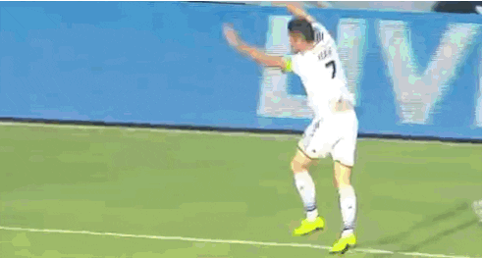
Thanks Patrizia!
Patrizia Rossi
Thu 10/3/2019 4:45 AM
Dear Marc,
many thanks for sending out this note to let us know about the commendable behaviour of Mary Ann and Mindy.
I am very proud of my group. patrizia

Slide 33
END
DSG makes crucial and critical contributions to all Halls
DSG staff well versed with detector hardware and software
Controls and Monitoring systems
Safety Interlock Systems
Detector modelling and detector performance analysis
Research and design
DSG staff
Tenacious problem solvers
Capable communicators
And most importantly have infectious pleasant personalities

Slide 34
Questions?

